Slide 1
Intro to Natural Language Processing Project Delivery #3 - Deep Learning based Text Classification
150118825 Ahmet Hakan Ekşİ
150117051 Metehan Ertan
150115025 Mert İsmail Eğİ

Slide 2
Dataset Selection
There is different options for dataset.
We chose the dataset from following link:
https://www.kaggle.com/kemical/kickstarter-projects
There is two different .csv file here.
We chose the .csv file named:
ks-projects-201801.csv

Slide 3
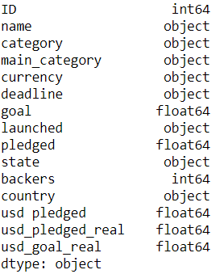
Dataset Description
378661 instance
15 attribute:
state attribute for predict if a project/campaign will be
successful or not, classification
pledged attribute for predict the
amount of money collected, regression

Slide 4
Classification

Slide 5
Approaches/ Preprocessing
We build 2 different approach.
1st one with only text attribute “name”, CNN, LSTM.
2nd one with mixed attributes. Consists of 2 models for 2 types of attributes.
We use MLP(ML Perceptron) for numerical, nominal attributes; main_category, country, usd_goal_real. We normalize numeric attributes, and encoding nominal, categorical attributes.
We use CNN, LSTM for text attribute like in our 1st approach.
And then we combine this two model.

Slide 6
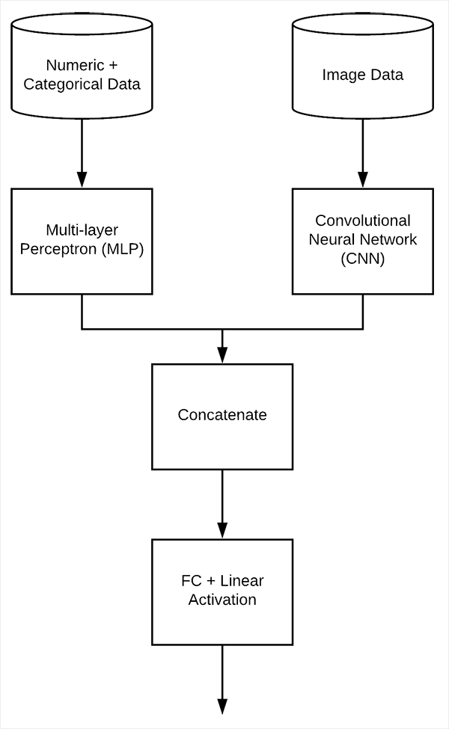
2nd Approach Detailed
Here is our second approach with mixed input.
We found this approach on the internet.
And use text data instead of image data.
And we also try LSTM instead of CNN.
Reference: https://www.pyimagesearch.com/2019/02/04/keras-multiple-inputs-and-mixed-data/

Slide 7
Preprocessing Class Label for Classification
Our class label generated from “state” attribute.
In state attribute we have 5 different types of value:
Failed, successful, canceled, undefined, suspended, live
We drop live campaigns. There is 375862 instance left
And we assign our class label 1 if state is “successful”, otherwise 0.

Slide 8
Preprocessing Textual Data for Classification
We use “GloVe” as word embeddings. We use the GloVe vector with 6B tokens and 300 dimensions.
We have only one textual attribute named “name”.

Slide 9
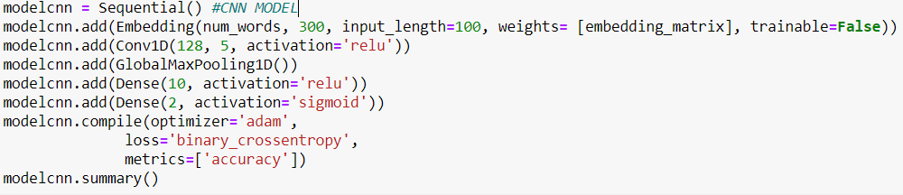
Outputs with Text Inputs – CNN, 1st Approach
Training Output: 187s 22ms/step - loss: 0.6034 - accuracy: 0.6629 - val_loss: 0.5895 - val_accuracy: 0.6754
Testing Output: 18s 8ms/step - loss: 0.6322 - accuracy: 0.6373

Slide 10
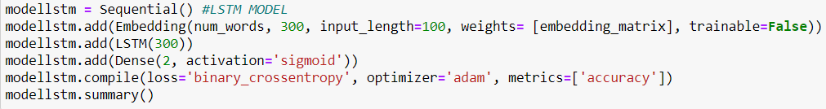
Outputs with Text Inputs – LSTM, 1st Approach
Training Output: 2443s 289ms/step - loss: 0.5991 - accuracy: 0.6679 - val_loss: 0.5893 - val_accuracy: 0.6744
Testing Output: 252s 107ms/step - loss: 0.6280 - accuracy: 0.6333

Slide 11
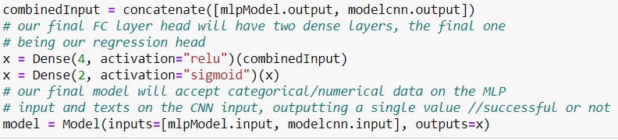
Outputs with Mixed Inputs – CNN, 2nd Approach
Training Output: 161s 19ms/step - loss: 0.6546 - accuracy: 0.6433 - val_loss: 0.6247 - val_accuracy: 0.6430
Testing Output: 17s 7ms/step - loss: 0.6400 - accuracy: 0.6451

Slide 12
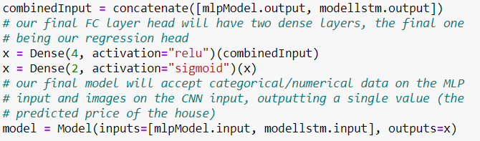
Outputs with Mixed Inputs – LSTM, 2nd Approach
Training Output: 2201s 260ms/step - loss: 0.6044 - accuracy: 0.6625 - val_loss: 0.5771 - val_accuracy: 0.6803
Testing Output: 244s 104ms/step - loss: 0.6042 - accuracy: 0.6537

Slide 13
Conclusion
For first approach, we have very close accuracy values, but LSTM takes too much time.
In second approach, we have better accuracy with LSTM, but it takes too much time here also.
Second approach(mixed inputs) improves our accuracy for both CNN, LSTM. And there is almost no time difference between two approaches.
And, I think we have achieved something here, because probability of predicting right in binary prediction is 0.5 but we get 0.65 accuracy.

Slide 14
Regression

Slide 15
Approaches/ Preprocessing
We use our second approach here.
We use MLP(ML Perceptron) for numerical, nominal attributes; main_category, country, usd_goal_real. We normalize numeric attributes, and encoding nominal, categorical attributes.
We use CNN, LSTM for text attribute.
And then we combine this two model.

Slide 16
Preprocessing “Pledged” for Regression
We change “pledged” values by dividing it into instance “goal”.
Then we have common logic for each instance.
We drop instances that is collect more money than its goal.
Then we have range between 0 and 1 for prediction.
There is 243441 instances left.

Slide 17
Preprocessing Textual Data for Classification
We use “GloVe” as word embeddings. We use the GloVe vector with 6B tokens and 300 dimensions.
We have only one textual attribute named “name”.

Slide 18
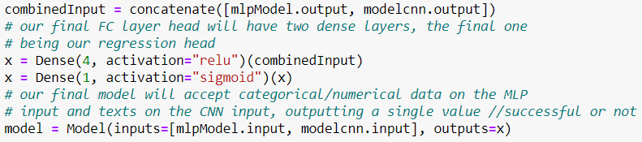
Outputs with Mixed Inputs – CNN, 2nd Approach
Training Output: 113s 19ms/step - loss: 67703509.2663 - mse: 0.1153 - mae: 0.2868 - mape: 67703509.2663 - val_loss: 12869646.0000 - val_mse: 0.0546 - val_mae: 0.1337 - val_mape: 12869646.0000
Testing Output:
predicted minimum: 0.0000000062358554, predicted maximum: 0.3552994430065155, predicted mean: 0.0559774860739708
test value minimum: 0.0000000000000000, test value maximum: 1.0000000000000000, test value mean: 0.1037705110751163
mse: 0.23356446957152685
mae: 0.1336586111550642

Slide 19
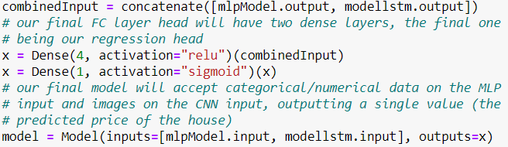
Outputs with Mixed Inputs – LSTM, 2nd Approach
Training Output: 1616s 265ms/step - loss: 100437526.5635 - mse: 0.1770 - mae: 0.3990 - mape: 100437526.5635 - val_loss: 8727333.0000 - val_mse: 0.0407 - val_mae: 0.1041 - val_mape: 8727333.0000
Testing Output:
predicted minimum: 0.0353583097457886, predicted maximum: 0.0471842586994171, predicted mean: 0.0410560891032219
test value minimum: 0.0000000000000000, test value maximum: 1.0000000000000000, test value mean: 0.1037705110751163
mse: 0.2017116543465942
mae: 0.1041053031337072

Slide 20
Conclusion
In regression, we have good mean squared error and mean absolute error, but I think we couldn't find a good approach. We have too much loss. And also, maybe just using the instances that collected money between 0 and its goal is not a good approach. And we use sigmoid as an activation function because our values between 0 and 1, but in regression most of the time linear function is used. We didn’t use linear function because when we used it, we get some negative result and collected money can’t be negative.
Most of the instances can’t reached their goals. Therefore, our model never predicted 1 which means pledged money equals campaign goals. This is also one of our model disadvantages.
**All the references cited in code…

